Slide 1
Exception Handling
And
I/O Fundamentals

Slide 2
Introduction
An exception is an event, which occurs during the execution of a program, that disrupts the normal flow of the program's instructions.
A Java exception is an object that describes an exceptional (that is, error) condition that has occurred in a piece of code.
An exception is an abnormal condition that arises in a code sequence at run time. In other words, an exception is a run-time error.
When an exceptional condition arises, an object representing that exception is created and thrown in the method that caused the error.
Exceptions can be generated by the Java run-time system, or they can be manually generated by our code.

Slide 3
Example:
import java.util.Scanner;
class ExceptionDemo
{
public static void main (String arr[])
{
System.out.println(“Enter two numbers”);
Scanner s = new Scanner (System.in);
int x = s.nextInt();
int y = s.nextInt();
int z = x/y;
System.out.println(“result of division is : ” + z);
}
}

Slide 4
Exception Handling
An Exception is a run-time error that can be handled programmatically in the application and does not result in abnormal program termination.
Exception handling is a mechanism that facilitates programmatic handling of run-time errors.
In java, each run-time error is represented by an object.

Slide 5
Exception (Class Hierarchy)
All exception types are subclasses of the built-in class Throwable. Thus, Throwable is at the top of the exception class hierarchy
There are two sub-classes of Throwable.
    Exception : can be handled
    Error : can’t be handled
    RuntimeException is the sub-class of Exception.
    Exceptions of this type are automatically defined for the programs that we write and include things such as division by zero and invalid array indexing.
    The other branch is topped by Error, which defines exceptions that are not expected to be caught under normal circumstances by your program.

Slide 6
Throwable
Exception Error
Run-time Exception - VirtualMachine
IOEXception - ArithmeticException - NoSuchMethod
SQLException - ArrayIndexOutOf - StackOverFlow
BoundsException
- NullPointerException
Checked Exception
Unchecked Exception

Slide 7
Checked Exception
Checked Exceptions are those, that have to be either caught or declared to be thrown in the method in which they are raised.
compiler forces the programmer to check and deal with the exceptions.
Unchecked Exception
Unchecked Exceptions are those that are not forced by the compiler either to be caught or to be thrown.
Unchecked Exceptions either represent common programming errors or those run-time errors that can’t be handled through exception handling.

Slide 8
Uncaught Exceptions
class Exception_Demo
{
public static void main(String args[])
{
int d = 0;
int a = 42 / d;
}
}
When the Java run-time system detects the attempt to divide by zero, it constructs a new exception object and then throws this exception.
once an exception has been thrown, it must be caught by an exception handler and dealt with immediately.

Slide 9
In the previous example, we haven’t supplied any exception handlers of our own.
So the exception is caught by the default handler provided by the Java run-time system.
Any exception that is not caught by your program will ultimately be processed by the default handler.
The default handler displays a string describing the exception, prints a stack trace from the point at which the exception occurred, and terminates the program.
java.lang.ArithmeticException: / by zero at Exc0.main(Exc0.java:4)

Slide 10
Why Exception Handling?
When the default exception handler is provided by the Java run-time system , why Exception Handling?
Exception Handling is needed because:
  it allows to fix the error, customize the message .
  it prevents the program from automatically terminating

Slide 11
Keywords for Exception Handling
try
catch
throw
throws
finally

Slide 12
Exception-Handling
Program statements that we want to monitor for exceptions are contained within a try block. If an exception occurs within the try block, it is thrown.
Our code can catch this exception (using catch) and handle it in some rational manner.
System-generated exceptions are automatically thrown by the Java run-time system. To manually throw an exception, use the keyword throw.
Any exception that is thrown out of a method must be specified as such by a throws clause.
Any code that absolutely must be executed after a try block completes is put in a finally block.

Slide 13
general form of an exception-handling block
try {
// block of code to monitor for errors
}
catch (ExceptionType1 exOb) {
// exception handler for ExceptionType1
}
catch (ExceptionType2 exOb) {
// exception handler for ExceptionType2
}
// ...
finally {
// block of code to be executed after try block ends
}

Slide 14
Using try and catch
A try and its catch statement form a unit. The scope of the catch clause is restricted to those statements specified by the immediately preceding try statement.
A catch statement cannot catch an exception thrown by another try statement. The statements that are protected by try must be surrounded by curly braces.

Slide 15
Using try and catch
class Exc2 {
public static void main(String args[]) {
int d, a;
try { // monitor a block of code.
d = 0;
a = 42 / d;
System.out.println("This will not be printed.");
}
catch (ArithmeticException e) { // catch divide-by-zero error
System.out.println("Division by zero.");
}
System.out.println("After catch statement.");
}
}

Slide 16
Demonstrate multiple catch statements
class Divide{
public static void main(String arr[]){
try {
int a= Integer.parseInt(arr[0]);
int b= Integer.parseInt(arr[1]);
int c = a/b;
System.out.println(“Result is: ”+c);
}
catch (ArithmeticException e)
{System.out.println(“Second number must be non-zero”);}
catch (NumberFormatException n)
{System.out.println(“Arguments must be Numeric”);}
catch (ArrayIndexOutOfBoundsException a)
{System.out.println(“Invalid Number of arguments”);}
}
}

Slide 17
Demonstrate multiple catch statements.
class MultiCatch {
public static void main(String args[]) {
try {
int a = args.length;
System.out.println("a = " + a);
int b = 42 / a;
int c[] = { 1 };
c[42] = 99;
} catch(ArithmeticException e) {
System.out.println("Divide by 0: " + e);
} catch(ArrayIndexOutOfBoundsException e) {
System.out.println("Array index oob: " + e);
}
System.out.println("After try/catch blocks.");
}
}

Slide 18
Demonstrate multiple catch statements.
C:\>java MultiCatch
a = 0
Divide by 0: java.lang.ArithmeticException: / by zero
After try/catch blocks.
C:\>java MultiCatch TestArg
a = 1
Array index oob: java.lang.ArrayIndexOutOfBoundsException:42
After try/catch blocks.

Slide 19
Demonstrate multiple catch statements.
When we use multiple catch statements, it is important to remember that exception subclasses must come before any of their super classes.
This is because a catch statement that uses a superclass will catch exceptions of that type plus any of its subclasses. Thus, a subclass would never be reached if it came after its superclass.

Slide 20
Demonstrate multiple catch statements.
class SuperSubCatch {
public static void main(String args[]) {
try {
int a = 0;
int b = 42 / a;
}
catch(Exception e) {
System.out.println("Generic Exception catch.");
}
/* This catch is never reached becauseArithmeticException is a subclass of Exception. */
catch(ArithmeticException e) { // ERROR - unreachable
System.out.println("This is never reached.");
}
}
}

Slide 21
Catching More Than One Type of Exception with One Exception Handler
In Java SE 7 and later, a single catch block can handle more than one type of exception.
This is called multi-catch feature which allows two or more exceptions to be caught by the same catch clause.
In the catch clause, specify the types of exceptions that block can handle, and separate each exception type with a vertical bar (|):
catch (IOException|SQLException ex)
{
// ….
}
Note: If a catch block handles more than one exception type, then the catch parameter is implicitly final. In this example, the catch parameter ex is final and therefore you cannot assign any values to it within the catch block.

Slide 22
Nested try Statements
The try statement can be nested. That is, a try statement can be inside the block of another try.
Each time a try statement is entered, the context of that exception is pushed on the stack.
If an inner try statement does not have a catch handler for a particular exception, the stack is unwound and the next try statement’s catch handlers are inspected for a match.
This continues until one of the catch statements succeeds, or until all of the nested try statements are exhausted.
If no catch statement matches, then the Java run-time system will handle the exception.

Slide 23
Nested try Statements
class NestTry {
public static void main(String args[]) {
try {
int a = args.length;
/* If no command-line args are present, the following statement will generate a divide-by-zero exception. */
int b = 42 / a;
System.out.println("a = " + a);
try { // nested try block
/* If one command-line arg is used, then a divide-by-zero exceptionvwill be generated by the following code. */
if(a==1) a = a/(a-a); // division by zero

Slide 24
Nested try Statements
/* If two command-line args are used, then generate an out-of-bounds exception. */
if(a==2) {
int c[] = { 1 };
c[42] = 99; // generate an out-of-bounds exception
}
} catch(ArrayIndexOutOfBoundsException e) {
System.out.println("Array index out-of-bounds: " + e);
}
} catch(ArithmeticException e) {
System.out.println("Divide by 0: " + e);
}
}
}

Slide 25
Nested try Statements
C:\>java NestTry
Divide by 0: java.lang.ArithmeticException: / by zero
C:\>java NestTry One
a = 1
Divide by 0: java.lang.ArithmeticException: / by zero
C:\>java NestTry One Two
a = 2
Array index out-of-bounds:
java.lang.ArrayIndexOutOfBoundsException:42

Slide 26
throw
It is possible for our program to throw an exception explicitly, using the throw statement. The general form of throw is shown here:
throw ThrowableInstance;
Here, ThrowableInstance must be an object of type Throwable or a subclass of Throwable. Primitive types, such as int or char, as well as non-Throwable classes, such as String and Object, cannot be used as exceptions.
‘throw’ keyword can be used:
to throw user defined exception
to customize the message to be displayed by predefined exceptions
to re-throw a caught exception
  Note: System-generated exceptions are automatically thrown by the Java run-time system.

Slide 27
throw
// Demonstrate throw.
class ThrowDemo
{
static void demo()
{
try {
throw new NullPointerException("demo");
}
catch(NullPointerException e)
{
System.out.println("Caught inside demo.");
throw e; // rethrow the exception
}
}
public static void main(String args[])
{
try {
demo();
}
catch(NullPointerException e)
{
System.out.println("Recaught: " + e);
}
}
}

Slide 28
Note: In the above example we use
throw new NullPointerException("demo");
new is used to construct an instance of NullPointerException.
Many of Java’s builtin run-time exceptions have at least two constructors: one with no parameter and one that takes a string parameter.
When the second form is used, the argument specifies a string that describes the exception. This string is displayed when the object is used as an argument to print( ) or println( ).

Slide 29
throws
If a method is capable of causing an exception that it does not handle, it must specify this behaviour so that callers of the method can guard themselves against that exception.
We do this by including a throws clause in the method’s declaration. A throws clause lists the types of exceptions that a method might throw.
This is the general form of a method declaration that includes a throws clause:
type method-name(parameter-list) throws exception-list
{
// body of method
}
Here, exception-list is a comma-separated list of the exceptions that a method can throw.

Slide 30
Example:
// This program contains an error and will not compile.
class ThrowsDemo
{
static void throwOne()
{
System.out.println("Inside throwOne.");
throw new IllegalAccessException("demo");
}
public static void main(String args[])
{
throwOne();
}
}
This example is incorrect program that tries to throw an exception that it does not catch. Because the program does not specify a throws clause to declare this fact, the program will not compile.

Slide 31
// This is now correct.
class ThrowsDemo {
static void throwOne() throws IllegalAccessException {
System.out.println("Inside throwOne.");
throw new IllegalAccessException("demo");
}
public static void main(String args[]) {
try {
throwOne();
} catch (IllegalAccessException e) {
System.out.println("Caught " + e);
}
}
}
main( ) must define a try/catch statement that catches this exception.

Slide 32
finally
finally creates a block of code that will be executed after a try/catch block has completed and before the code following the try/catch block.
The finally block will execute whether or not an exception is thrown. If an exception is thrown, the finally block will execute even if no catch statement matches the exception.
Any time a method is about to return to the caller from inside a try/catch block, via an uncaught exception or an explicit return statement, the finally clause is also executed just before the method returns.
This can be useful for closing file handles and freeing up any other resources that might have been allocated at the beginning of a method with the intent of disposing of them before returning.
The finally clause is optional. However, each try statement requires at least one catch or a finally clause.

Slide 33
finally
// Demonstrate finally.
class FinallyDemo { // Through an exception out of the method.
static void procA() {
try {
System.out.println("inside procA");
throw new RuntimeException("demo");
} finally {
System.out.println("procA's finally");
}
}
// Return from within a try block.
static void procB() {
try {
System.out.println("inside procB");
return;
} finally {
System.out.println("procB's finally");
}
}

Slide 34
finally
// Execute a try block normally.
static void procC() {
try {
System.out.println("inside procC");
} finally {
System.out.println("procC's finally");
}
}
public static void main(String args[]) {
try {
procA();
} catch (Exception e) {
System.out.println("Exception caught");
}
procB();
procC();
}
}

Slide 35
Java’s Built-in Exceptions
Inside the standard package java.lang, Java defines several exception classes. The most general of these exceptions are subclasses of the standard type RuntimeException.
These exceptions need not be included in any method’s throws list. In the language of Java, these are called unchecked exceptions because the compiler does not check to see if a method handles or throws these exceptions.
The exceptions defined by java.lang that must be included in a method’s throws list if that method can generate one of these exceptions and does not handle it itself. These are called checked exceptions.
Java defines several other types of exceptions that relate to its various class libraries.

Slide 36
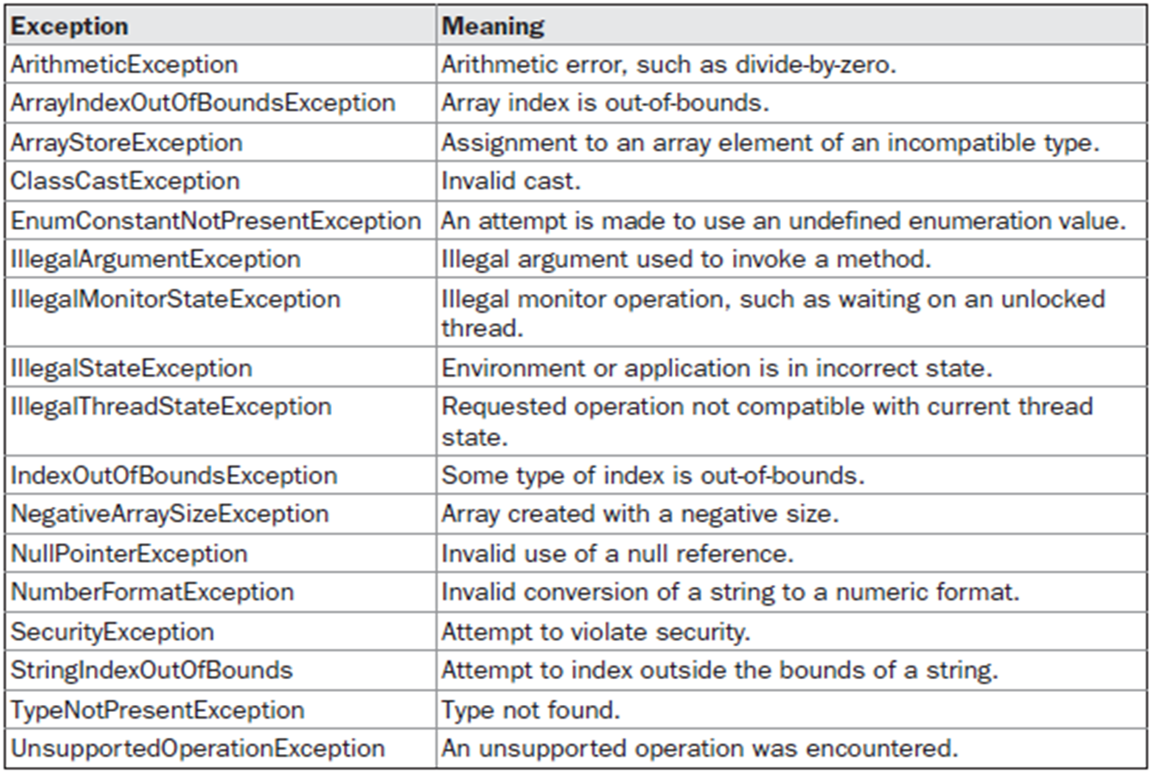
Java’s Unchecked RuntimeException Subclasses Defined in java.lang

Slide 37
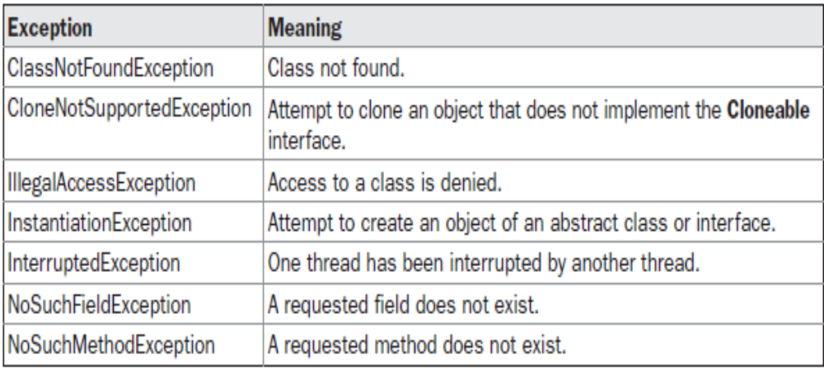
Java’s Checked Exceptions Defined in java.lang

Slide 38
Defining Custom Exceptions
We can create our own Exception sub-classes by inheriting Exception class.
The Exception class does not define any methods of its own.
It inherits those methods provided by Throwable.
Thus, all exceptions, including those that we create, have the methods defined by Throwable available to them.

Slide 39
Constructor for creating Exception
Exception( )
Exception(String msg)
A custom exception class is represented by a subclass of Exception / Throwable.
It contains the above mentioned constructor to initialize custom exception object.

Slide 40
Creating Own Exception Subclasses
class MyException extends Exception
{
private int detail;
MyException(int a) {
detail = a;
}
public String toString() {
return "MyException[" + detail + "]";
}
}
class ExceptionDemo {
static void compute(int a) throws MyException {
System.out.println("Called compute(" + a + ")");
if(a > 10)
throw new MyException(a);
System.out.println("Normal exit");
}
public static void main(String args[]) {
try {
compute(1);
compute(20);
} catch (MyException e) { System.out.println("Caught " + e); }
}
}

Slide 41
import java.util.*;
class NegativeCircleRadiusException extends Exception
{
public String toString()
{
return "Radius of Circle cannot be nagative";
}
}
class Circle
{ double radius;
Circle(double r)
{ radius=r;
}
double area() throws NegativeCircleRadiusException
{
if(radius<0.0)
{
throw new NegativeCircleRadiusException();
}
else
return 3.14*radius*radius;
}
}

Slide 42
class TestNegativeRadius
{
public static void main(String[] args)
{
Scanner sc= new Scanner(System.in);
System.out.println("Enter Radius of Circle");
double x=sc.nextDouble();
Circle c1=new Circle(x);
try
{
double d=c1.area();
System.out.println("Area of Circle is"+d);
}
catch(NegativeCircleRadiusException e)
{
System.out.println(e);
}
}
}

Slide 43
(NumberFormatException) Write a program that prompts the user to read two integers and displays their sum. Your program should prompt the user to read the number again if the input is incorrect .
Write a program that prompts the user to read radius of circle and display the area of circle if radius given by user is positive otherwise throw NegativeCircleRadiusException.
Write a java program to define the Rectangle class with two fields length and breadth. In a Rectangle, both of these fields should be positive to calculate the area of rectangle. Create the IllegalSideException class to throw an IllegalSideException object if a rectangle is created with sides having negative value.

Slide 44
(IllegalTriangleException) Defined the Triangle class with three sides. In a triangle, the sum of any two sides is greater than the other side and any sides can not be negative. The Triangle class must adhere to this rule. Create the IllegalTriangleException class, and modify the constructor of the Triangle class to throw an IllegalTriangleException object if a triangle is created with sides that violate. Your program should prompt the user to reenter the sides again if violating above rule .
the rule, as follows:
/** Construct a triangle with the specified sides */
public Triangle(double side1, double side2, double side3)
throws IllegalTriangleException {
// Implement it
}

Slide 45
Assertions

Slide 46
An assertion is a statement in the Java programming language that enables you to test your assumptions about your program.
For example, you might have a method that should always return a positive integer value.
You might test this by asserting that the return value is
greater than zero using an assert statement. At run time, if the condition is true, no other action takes place. However, if the condition is false, then an AssertionError is thrown.
An assertion uses assert keyword.

Slide 47
The assert keyword has two forms. The first is shown here:
assert condition;
where
condition is a boolean expression. When the system runs the assertion, it evaluates condition and if it is false throws an AssertionError with no detail message.
The second form of assert is shown here:
assert condition: expr;
where:
Condition is a boolean expression.
expr is an expression that has a value. (It cannot be an invocation of a method that is declared void.)
Use this version of the assert statement to provide a detail message for the AssertionError. The system passes the value of expr to the appropriate AssertionError constructor, which uses the string representation of the value as the error's detail message.

Slide 48
To enable assertion checking at run time, you must specify the -ea option. For example:
java -ea <Class Name>

Slide 49
// Demonstrate assert.
class AssertDemo
{
static int val = 3;
static int getnum()
{
return val--;
}
public static void main(String args[])
{
int n;
for(int i=0; i < 10; i++)
{
n = getnum();
assert n > 0; // will fail when n is 0
System.out.println("n is " + n);
}
}
}

Slide 50
// Demonstrate assert Second Form.
class AssertDemo
{
static int val = 3;
static int getnum()
{
return val--;
}
public static void main(String args[])
{
int n;
for(int i=0; i < 10; i++)
{
n = getnum();
assert n > 0 : "n is negative!"; // will fail when n is 0 with message
System.out.println("n is " + n);
}
}
}

Slide 51
One important point to understand about assertions is that you must not rely on them
to perform any action actually required by the program. The reason is that normally,
released code will be run with assertions disabled. For example,
// A poor way to use assert!!!
class AssertDemo
{
static int val = 3;
// Return an integer.
static int getnum() {
return val--;
}
public static void main(String args[])
{
int n = 0;
for(int i=0; i < 10; i++)
{
assert (n = getnum()) > 0; // This is not a good idea!
System.out.println("n is " + n);
}
}
}

Slide 52
File and Input/output Streams

Slide 53
The File Class
Data stored in variables, arrays, and objects are temporary; they are lost when the program terminates.
To permanently store the data created in a program, you need to save them in a file on a disk or a CD.
File class is present in java.io package and It deals directly with files and the file system.
Every file is placed in a directory in the file system.

Slide 54
An absolute file name contains a file name with its complete path and drive letter.
For example, c:\book\Welcome.java is the absolute file name for the file Welcome.java on the Windows operating system.
Here c:\book is referred to as the directory path for the file.
Absolute file names are machine dependent

Slide 55
Do not use absolute file names in your program. Why?
You should use a file name relative to the current directory. Known as relative path For example,
you may create a File object using new File("Welcome.java") for the file Welcome.java in the current directory.
You may create a File object using new File(“abc/Welcome .java").
The forward slash(/) is the Java directory separator, which will work same as in other platform.

Slide 56
The File class does not specify how information is retrieved from or stored in files.
File class can be used to obtain or manipulate the information associated with a disk file, such as file permissions, renaming or delete a file.

Slide 57
A directory is a File that contains a list of other files and directories.
The following constructors can be used to create File objects:
File(String directoryPath)
File(String directoryPath, String filename)
File(File dirObj, String filename)
Here , directoryPath is the path name of the file, filename is the name of the file or subdirectory, and dirObj is a File object that specifies a directory that describes a file.

Slide 58
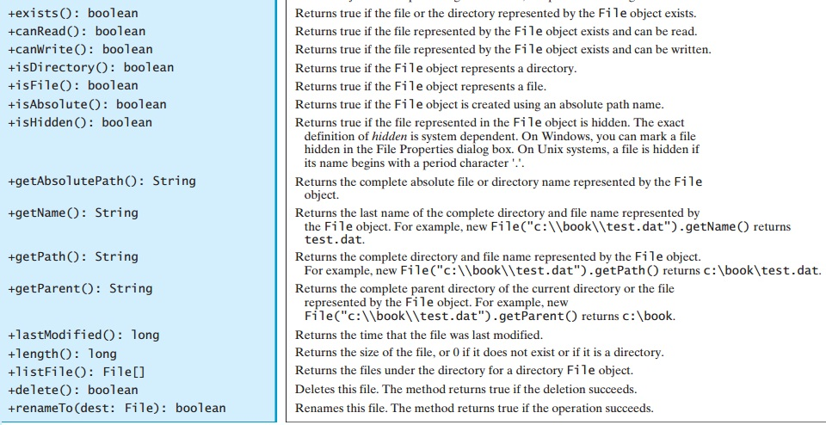

Slide 59
public boolean createNewFile() throws IOException: Atomically creates a new, empty file named if and only if a file with this name does not yet exist.
A File object encapsulates the properties of a file or a path, but does not contain the methods for reading/writing data from/to a file.
In order to perform I/O, you need to create objects using appropriate Java I/O classes.

Slide 60
import java.io.File;
class FileDemo {
public static void main(String args[])
{
File f1 = new File("javaFile123.txt");
System.out.println("File Name: " + f1.getName());
System.out.println("Path: " + f1.getPath());
System.out.println("Abs Path: " + f1.getAbsolutePath());
System.out.println("Parent: " + f1.getParent());
System.out.println(f1.exists() ? "exists" : "does not exist");
System.out.println(f1.canWrite() ? "is writeable" : "is not writeable");
System.out.println(f1.canRead() ? "is readable" : "is not readable");
System.out.println("is " + (f1.isDirectory() ? "" : "not" + " a directory"));
System.out.println(f1.isFile() ? "is normal file" : "might be a named pipe");
System.out.println(f1.isAbsolute() ? "is absolute" : "is not absolute");
System.out.println("File last modified: " + f1.lastModified());
System.out.println("File size: " + f1.length() + " Bytes");
}
}
Notes:
FileDemo1.java

Slide 61
Text I/O Vs Binary I/O
Data stored in a binary file are represented in binary form. You cannot read binary files. They are designed to be read by programs.
Computers do not differentiate binary files and text files. All files are stored in binary format, and thus all files are essentially binary files.
Text I/O is built upon binary I/O to provide a level of abstraction for character encoding and decoding.
Encoding and decoding are automatically performed by them for text I/O.

Slide 62
Streams
Java programs perform I/O through streams. A stream is an abstraction that either produces or consumes information.
A stream is linked to a physical device by the Java I/O system.
All streams behave in the same manner, even if the actual physical devices to which they are linked differ. Thus, the same I/O classes and methods can be applied to any type of device.
All these streams represent an input source and an output destination

Slide 63
The Byte Stream Classes
Byte streams are defined by using two class hierarchies. At the top are two abstract classes: InputStream and OutputStream.
Each of these abstract classes has several concrete subclasses that handle the differences between various devices, such as disk files, network connections, and even memory buffers.
The abstract classes InputStream and OutputStream define several key methods that the other stream classes implement. Two of the most important are read( ) and write( ), which, respectively, read and write bytes of data.
Both methods are declared as abstract inside InputStream and OutputStream. They are overridden by derived stream classes.

Slide 64
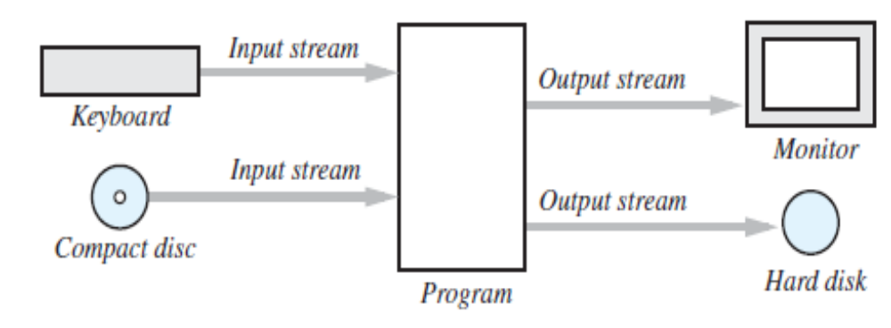
The Concept of a Stream
A stream is a flow of data. The data might be characters, numbers, or bytes consisting of binary digits.
If the data flows into your program, the stream is called an input stream.
If the data flows out of your program, the stream is called an output stream.
For example, if an input stream is connected to the keyboard, the data flows from the keyboard into your program. If an input stream is connected to a file, the data flows from the file into your program. Figure below illustrates some of these streams.

Slide 65
Byte Streams and Character Streams
Java defines two types of streams: byte and character.
Byte streams provide a convenient means for handling input and output of bytes. Byte streams are used, for example, when reading or writing binary data.
Programs use byte streams to perform input and output of 8-bit bytes. All byte stream classes are descended from InputStream and OutputStream.
Character streams provide a convenient means for handling input and output of characters.
The Java platform stores character values using Unicode conventions. Character stream I/O automatically translates this internal format to and from the local character set.
At the lowest level, all I/O is byte-oriented. The character-based streams simply provide a convenient and efficient means for handling characters.
All character stream classes are descended from Reader and Writer.

Slide 66
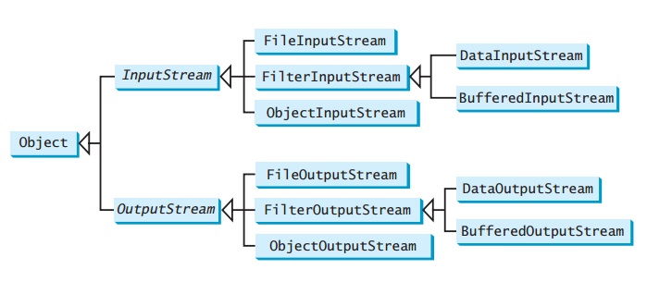
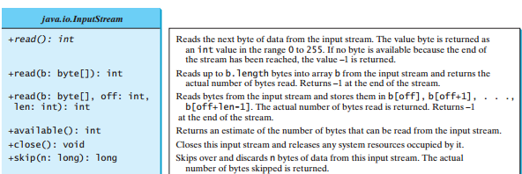

Slide 67
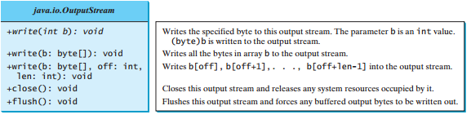

Slide 68
The Character Stream Classes
Character streams are defined by using two class hierarchies. At the top are two abstract classes, Reader and Writer.
These abstract classes handle Unicode character streams. Java has several concrete subclasses of each of these.
The abstract classes Reader and Writer define several key methods that the other stream classes implement. Two of the most important methods are read( ) and write( ).

Slide 69
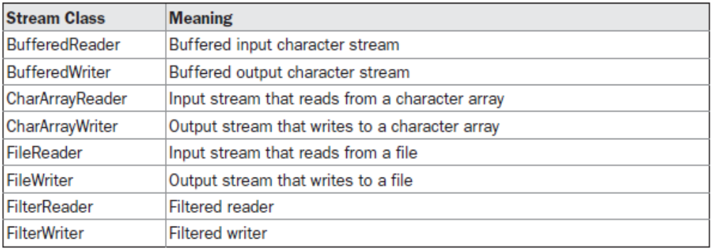
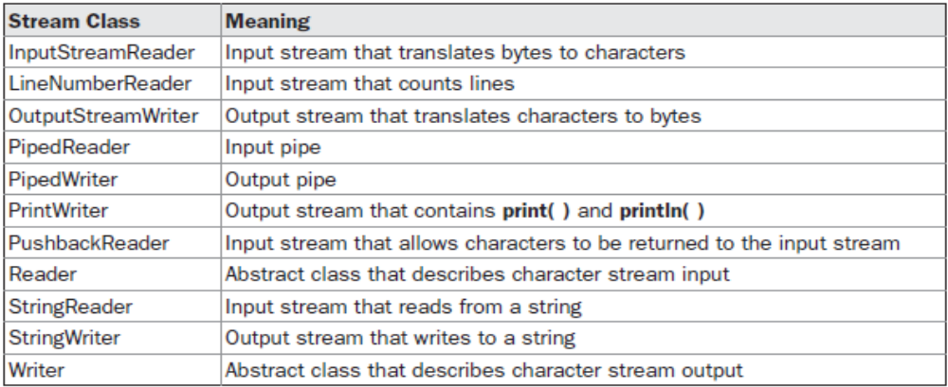
The Character Stream Classes

Slide 70
The Predefined Streams
As all Java programs automatically import the java.lang package. This package defines a class called System, which encapsulates several aspects of the run-time environment.
For example, using some of its methods, we can obtain the current time and the settings of various properties associated with the system.
System also contains three predefined stream variables: in, out, and err.
These fields are declared as public, static, and final within System.
System.out refers to the standard output stream. By default, this is the console. System.in refers to standard input, which is the keyboard by default. System.err refers to the standard error stream, which also is the console by default.
System.in is an object of type InputStream; System.out and System.err are objects of type PrintStream. These are byte streams, even though they typically are used to read and write characters from and to the console. As we can wrap these within character based streams, if desired.

Slide 71
FileInputStream
The FileInputStream class creates an InputStream that you can use to read bytes from a file. Its two most common constructors are shown here:
FileInputStream(String filepath)
FileInputStream(File fileObj)
Either can throw a FileNotFoundException. Here, filepathis the full path name of a file, and fileObj is a File object that describes the file.

Slide 72
import java.io.*;
public class InputStreamDemo
{ public static void main(String[] args) throws IOException
{ FileInputStream fis = null;
int i = 0;
char c;
try
{ fis = new FileInputStream("test.txt");
while((i=fis.read())!=-1)
{
c=(char)i;
System.out.print(c);
}
}
catch(FileNotFoundException ex){System.out.println(“File not found”); }
finally{ if(fis!=null)
fis.close();
}
}
}
Notes:
InputStreamDemo.java

Slide 73
FileOutputStream
FileOutputStream creates an OutputStream that you can use to write bytes to a file. Its most commonly used constructors are shown here:
FileOutputStream(String filePath)
FileOutputStream(File fileObj)
FileOutputStream(String filePath, boolean append)
FileOutputStream(File fileObj, boolean append)
If the file does not exist, a new file will be created. If the file already exists, the first two constructors will delete the current content of the file. To retain the current content and append new data into the file, use the last two constructors by passing true to the append parameter.
They can throw a FileNotFoundException. Here, filePathis the full path name of a file, and fileObjis aFileobject that describes the file
In the case where you attempt to open a read-only file, an IOException will be thrown.

Slide 74
Closing a stream when it's no longer needed is very important — A finally block to guarantee that streams will be closed even if an error occurs. This practice helps avoid serious resource leaks.
Since test.txt contains character data, the good approach is to use character streams. There are also streams for more complicated data types. Byte streams should only be used for the most primitive I/O.

Slide 75
import java.io.*;
public class OutputStreamDemo
{
public static void main(String[] args) throws IOException
{
FileOutputStream fos = null;
String s = "This text will be written in the file";
byte buf[] = s.getBytes();
try
{
fos = new FileOutputStream("test1.txt");
for (int i=0; i < buf.length; i++)
{
fos.write(buf[i]);
}
}catch(FileNotFoundException e){System.out.println(“File not found”);}
finally
{
fos.close();
}
}
}
Notes:
OutputStreamDemo.java

Slide 76
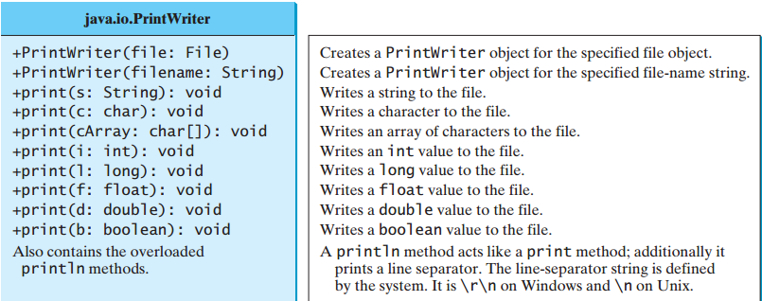
Writing Data into file using PrintWriter
Thejava.io.PrintWriter class can be used to create a file and write data to a text file.
PrintWriter output = newPrintWriter(filename);
Then, you can invoke the print,println methods on PrintWriter object

Slide 77
public class PrintWriterDemo1
{
public static void main(String[] args) throws Exception
{
java.io.File f = new java.io.File("b.txt");
java.io.PrintWriter pw = new java.io.PrintWriter(f);
pw.print("Java class ");
pw.println(40);
pw.print("LPU ");
pw.println(85.5);
pw.print('a');
pw.close();
}
}
Notes:
PrintWriterDemo1.java

Slide 78
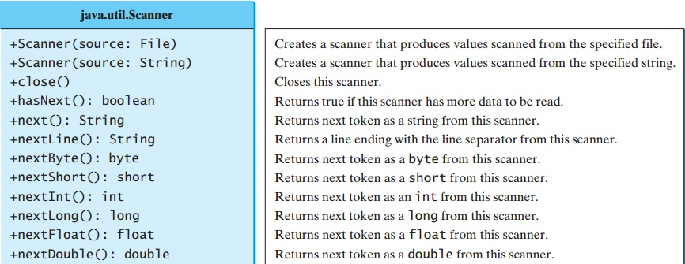
Reading file Using Scanner
The java.util.Scanner class was used to read strings and primitive values from the console
Scanner input = new Scanner(System.in);
To read from a file, create a Scanner for a file, as follows:
Scanner input = new Scanner(new File(filename));

Slide 79
import java.util.Scanner;
public class ReadFile
{
public static void main(String[] args) throws Exception
{
java.io.File f1 = new java.io.File("b.txt");
Scanner a1 = new Scanner(f1);
while(a1.hasNext())
{
String s = a1.nextLine();
System.out.println(s);
}
a1.close();
}
}
Notes:
ReadFile.java

Slide 80
Serialization
Serialization is the process of writing the state of an object to a byte stream.
This is useful when we want to save the state of our program to a persistent storage area, such as a file.
At a later time, we may restore these objects by using the process of de-serialization.
Serialization is also needed to implement Remote Method Invocation (RMI).

Slide 81
Serialization: Interfaces and Classes
An overview of the interfaces and classes that support serialization follows:
Serializable
  Only an object that implements the Serializable interface can be saved and restored by the serialization facilities.
  The Serializable interface defines no members.
  It is simply used to indicate that a class may be serialized.
  If a class is serializable, all of its subclasses are also serializable.

Slide 82
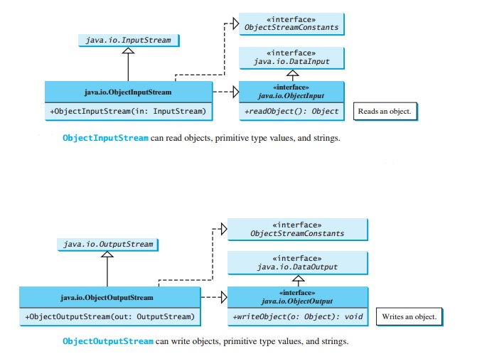

Slide 83
All of these methods will throw an IOException on error conditions.
The readObject() method may throw java.lang. ClassNotFoundException. The reason is that when the JVM restores an object, it first loads the class for the object if the class has not been loaded.
ClassNotFoundException is a checked exception,

Slide 84
Serialization Example
class MyClass implements Serializable
{
String s;
int i;
double d;
public MyClass(String s, int i, double d) {
this.s = s;
this.i = i;
this.d = d;
}
public String toString()
{
return "s=" + s + "; i=" + i + "; d=" + d;
}
}
Notes:
Student.java

Slide 85
import java.io.*;
public class SerializationDemo {
public static void main(String args[]) {
try {
MyClass object1 = new MyClass("Hello", -7, 2.70);
System.out.println("object1: " + object1);
FileOutputStream fos = new FileOutputStream("serial");
ObjectOutputStream oos = new ObjectOutputStream(fos);
oos.writeObject(object1);
oos.flush();
oos.close();
}
catch(IOException e) {
System.out.println("Exception during serialization: " + e);
System.exit(0);
}
Notes:
SerializationDemo.java

Slide 86
// Object deserialization
try {
MyClass object2;
FileInputStream fis = new FileInputStream("serial");
ObjectInputStream ois = new ObjectInputStream(fis);
object2 = (MyClass)ois.readObject();
ois.close();
System.out.println("object2: " + object2);
}
catch(Exception e) {
System.out.println("Exception during deserialization: " + e);
System.exit(0);
}
}
}
Notes:
final1.java

Slide 87


